Slide 1
Cross scheme transaction
Handling of Time Outs
Contribution by : PAYSYS LABS

Slide 2
Context
These slides are created to present and discuss the changes required in the transfer flow when performing a cross-scheme transaction between multiple payment systems.
Three scenarios are considered for discussion
  Integration of Multiple payment systems via a Hub and Spoke model
  Integration of all Participating DFSPs directly to a single Regional payment system
  Bi-lateral integration of two payment systems
An underlying assumption is that one or more payment systems in such scenario will be non-Mojaloop and built on standard ISO20022 compliant messages and message flow.

Slide 3
Scenario 1
Example of this is the model being adopted by CBC
(based on presentation given by CBC in last convening sharing the results of the POC)
An example of this model is the Regional Payment and Settlement System (REPSS) of the Common Market for Eastern and Southern Africa. REPSS has a common clearing house in the middle and the Central Bank of Mauritius acts as a common settlement agent, which debits and credits the accounts of the participating central banks on its books. (Source BIS)
Central Bank “X”
Central Bank “X” is authorized by Country A and Country B central bank to settle the obligations between both schemes.
Regional Payment System
National Payment system (Country A)
National Payment system (Country B)
FX Providers
FX Providers
FX Providers
FX Providers
Multiple national schemes interoperating via a Regional scheme
DFSP-A1
DFSP-A2
DFSP-A3
DFSP-B1
DFSP-B2
DFSP-B3

Slide 4
Scenario 2
Example of this model is BUNA which allows cross jurisdiction transfers between participating institutions
The Regional Payment system, onboards both the Participants in each country + the Fund Holding Institutions (FHI) – Central Banks in each country to guarantee the Irrevocability of the transactions that are posted in its Central Ledger.
Regional Payment System
FX Providers
FX Providers
FX Providers
FX Providers
Multiple country participants connecting a regional payment system directly.
DFSP-A1
DFSP-A2
DFSP-A3
DFSP-B1
DFSP-B2
DFSP-B3

Slide 5
Scenario 3
An example of a bilateral link model is Directo a México, which was set up in 2005 between the United States and Mexico and links the Federal Reserve’s automated clearing house (FedACH) with the Mexican RTGS system (SPEI). Other examples are the links between the FPS of Singapore (PayNow) and Thailand (Promptpay) set up in 2021, Singapore (PayNow) and India (UPI) set up in February 2023, as well as Hong Kong (FPS) and Thailand (PromptPay) to be launched by the end of 2023. (Source BIS)
National Payment system (Country A)
National Payment system (Country B)
Two National Schemes (or Two schemes within a country) interoperate bilaterally
DFSP-A1
DFSP-A2
DFSP-A3
DFSP-B1
DFSP-B2
DFSP-B3

Slide 6
Assumptions
Our slides focus on Scenario 1 based on the assumption that CBC (which is an upcoming adopter) of Mojaloop has taken a decision to follow the model which REPSS is currently following.
Bank of Mauritius will be the Central bank in which all participating country Central Banks have accounts and the funds will be settled in BoM.
Regional Hub guarantees the irrevocability of the clearing instructions that are posted in its Central ledger. It does that by ensuring that the Limits for each participating National payment scheme are based on the funds reserved by that country’s central bank in BoM (the regional settlement bank)

Slide 7
Common Terms
Term | Meaning | Additional note
Payer DFSP | The DFSP initiating the cross scheme transfer. This DFSP is participant of Payer Scheme and settles all its obligations with Payer Scheme’s payment system
Payer Scheme | The Scheme which receives payment instructions from Payer DFSP and sends them over to a Regional Scheme or another Payee Scheme with whose payment system its bilaterally connected
Regional Hub or Hub | Regional Payment system in a Hub and Spoke Model
Payee Scheme | The scheme receiving the payment from another payment system (either the Payer scheme’s payment systems or Regional Hub)
Payee DFSP | The institution receiving a cross-border transfer or payment. The Payee DFSP only settles with Payee Scheme.

Slide 8
Scenario 1 – Regional Hub model

Slide 9
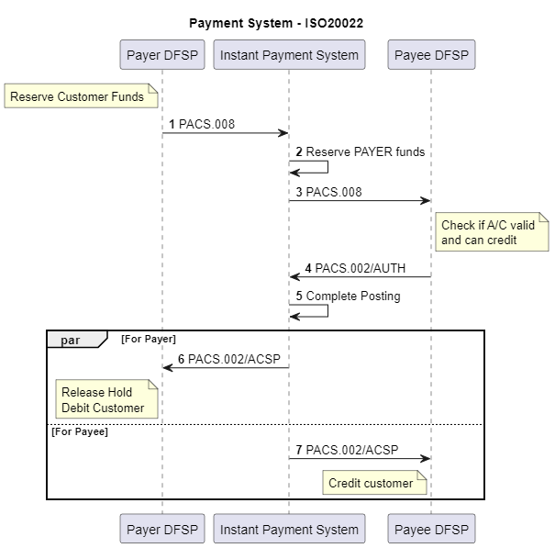
Standard* flow of a Clearing instruction in Instant payment system
Global standard
Ensures IPS manages the finality and irrevocability.
If Payee Times out (between Step 3 and 4) then IPS rejects both; This ensure certainty within a given time period.
The term standard is being used as for Instant payments most of the deployments that have used ISO20022 messages natively work on this same pattern for P2P transfers. This includes
  USA
  Pakistan
  Ethiopia
  Kenya
  Mauritius
  Rwanda
  BUNA (Arab world)
  Azerbaijan

Slide 10
What changes in a cross-scheme scenario
Just like PAYER DFSP is a participant of “Payer Scheme” and PAYEE DFSP is a participant of PAYEE Scheme, the National Payment systems in “Scenario 1” are participants of the Regional Hub.
The “PAYEE” scheme when it receives a clearing instruction (/transfer in Mojaloop and PACS.008 in ISO20022), will give it to its PAYEE DFSP participant to reserve funds. Mojaloop can be setup in a manner that participant reserves funds and not credits on receiving /transfer.
In a Hub and Spoke model, the Regional hub is the one which guarantees the irrevocability of the transfer. Hence the PAYER and PAYEE scheme (which are essentially payment systems represented by their proxies as participant in the Regional Hub) need to follow the notifications from “Regional Hub” to take the decision to finalize the transaction.
Payee Scheme on receiving a confirmation from Payee DFSP will not post the transaction in Central Ledger and hold the posting as Pending till it gets either a positive or negative notification from Regional Hub.

Slide 11
Suggested Flows – Sequence diagram
Scenario | Link to sequence diagram
Positive flow – Regional Hub | ML-Cross Scheme.wsd
Time Out by Payer Scheme | ML-Cross Scheme - timeout.wsd

Slide 12
Why do we required Payee Scheme to hold the posting
The Payee scheme cannot guarantee the availability of funds to “PAYEE DFSP” until it has not received a guarantee of funds from Regional Hub.
If Payee Scheme posts the entry in its central ledger, then in case of a time out scenario between Payee Scheme and Regional Hub, it will create an inconsistent position because Regional Hub will release the blocked liquidity of Payer Scheme who will in turn release liquidity of Payer DFSP.
This will result in a situation where Payee has received funds and Payer does not receive confirmation of transaction being successful and Payer funds are released as well.

